Slide 1
Irrigation System Hardware
Marvin, Ian, Christian, Froilan, Varun , Daniel
Notes:
Hi my name is Varun and I am part of the Irrigation Hardware Team. I’m going to start of by introducing the team, this is Marvin Team Captain and Hardware Designer, Chris Daniel and Myself are the Interface Designers, Froilan the Menu Designer, and Ian who is the Systems Integrator.

Slide 2
Table of Contents
Introduction
Components
Testing
Diagrams
Conclusion
Questions
Notes:
During this presentation we’ll first be discussing about components, testing, diagrams, conclusion, and then we’ll open the floor for questions

Slide 3
Introduction

Slide 4
Irrigation System Applications
Golf Courses
Universities
Municipalities
Soccer / Football Fields
Theme Parks
Farming / Hydroponics
Notes:
Irrigation systems are widely used in various industries such as Golf Courses, Campuses, Municipalities, Recreational Fields, Theme Parks, and Farming/Hydroponics.

Slide 5
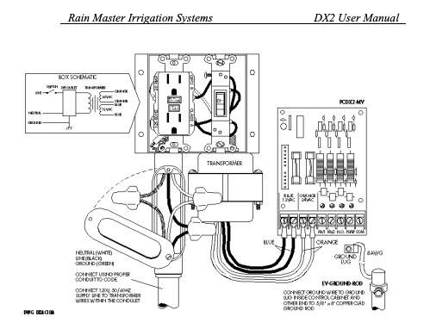
Commercial Model
Hardware technology is outdated
Software is unreliable
Latest update is 10 years ago
Interfacing with other systems is difficult
Notes:
Commercial Irrigation systems currently on the market retail for several thousands of dollars however, our irrigation system costs a fraction to manufacture. This is possible because we source readily available parts such as the Raspberry Pi and a STM microcontroller.
Few flaws of the commercial irrigation systems are that the hardware technology is outdated and the software is unreliable. Interfacing with other systems proves to be difficult.
The benefit of our system is that it is written using easily modifiable code and modern computer interfaces which is easy to maintain, modify, and understand.

Slide 6
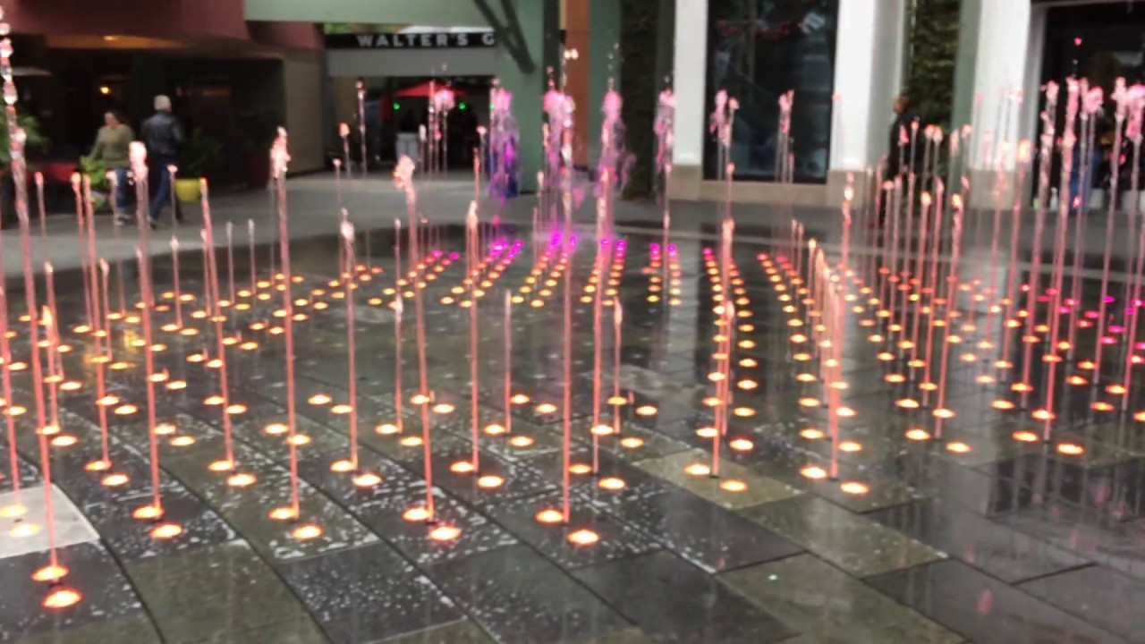
Abstract
We want to create a low cost alternative to the current expensive model on the market with a simpler user friendly design. Maximizing ease of troubleshooting and installation for new users. Additionally, our system allows for better water control and conservation.
Notes:
Our intention when it came to the Senior Design project was to create a low cost alternative irrigation system with a simpler User friendly Interface which would help Maximize the ease of troubleshooting and installation for new users

Slide 7
Project Goals
Design a low cost and user friendly irrigation system with readily available parts (Raspberry PI, STM32)
Allow the system to be controlled through a web application from almost any internet enabled device
Make the system fully scalable to support as many sprinkler valves as needed
Notes:
The system will be controlled via a web application that was developed by our Sister team the Irrigation Software Team, which will allow the user to schedule when they want to operate the system.
Our system can support up to 256 valves per Raspberry Pi but, technically it can support an unlimited amount of valves with enough infrastructure.

Slide 8
Project Goals
Make it simple to identify when a specific sprinkler zone has malfunctioned.
Have the ability to monitor water usage and automatically close a water line in the event of a burst.
Allow the system to be adaptable to applications other than irrigation (Check out our display table!).
Notes:
We also wanted to make it possible to identify when a specific sprinkler zone has malfunctioned and in the event of a mishap, automatically close the water line in response. Our goals are to monitor water usage, and create an adaptable unit with flexible application.

Slide 9
Components

Slide 10
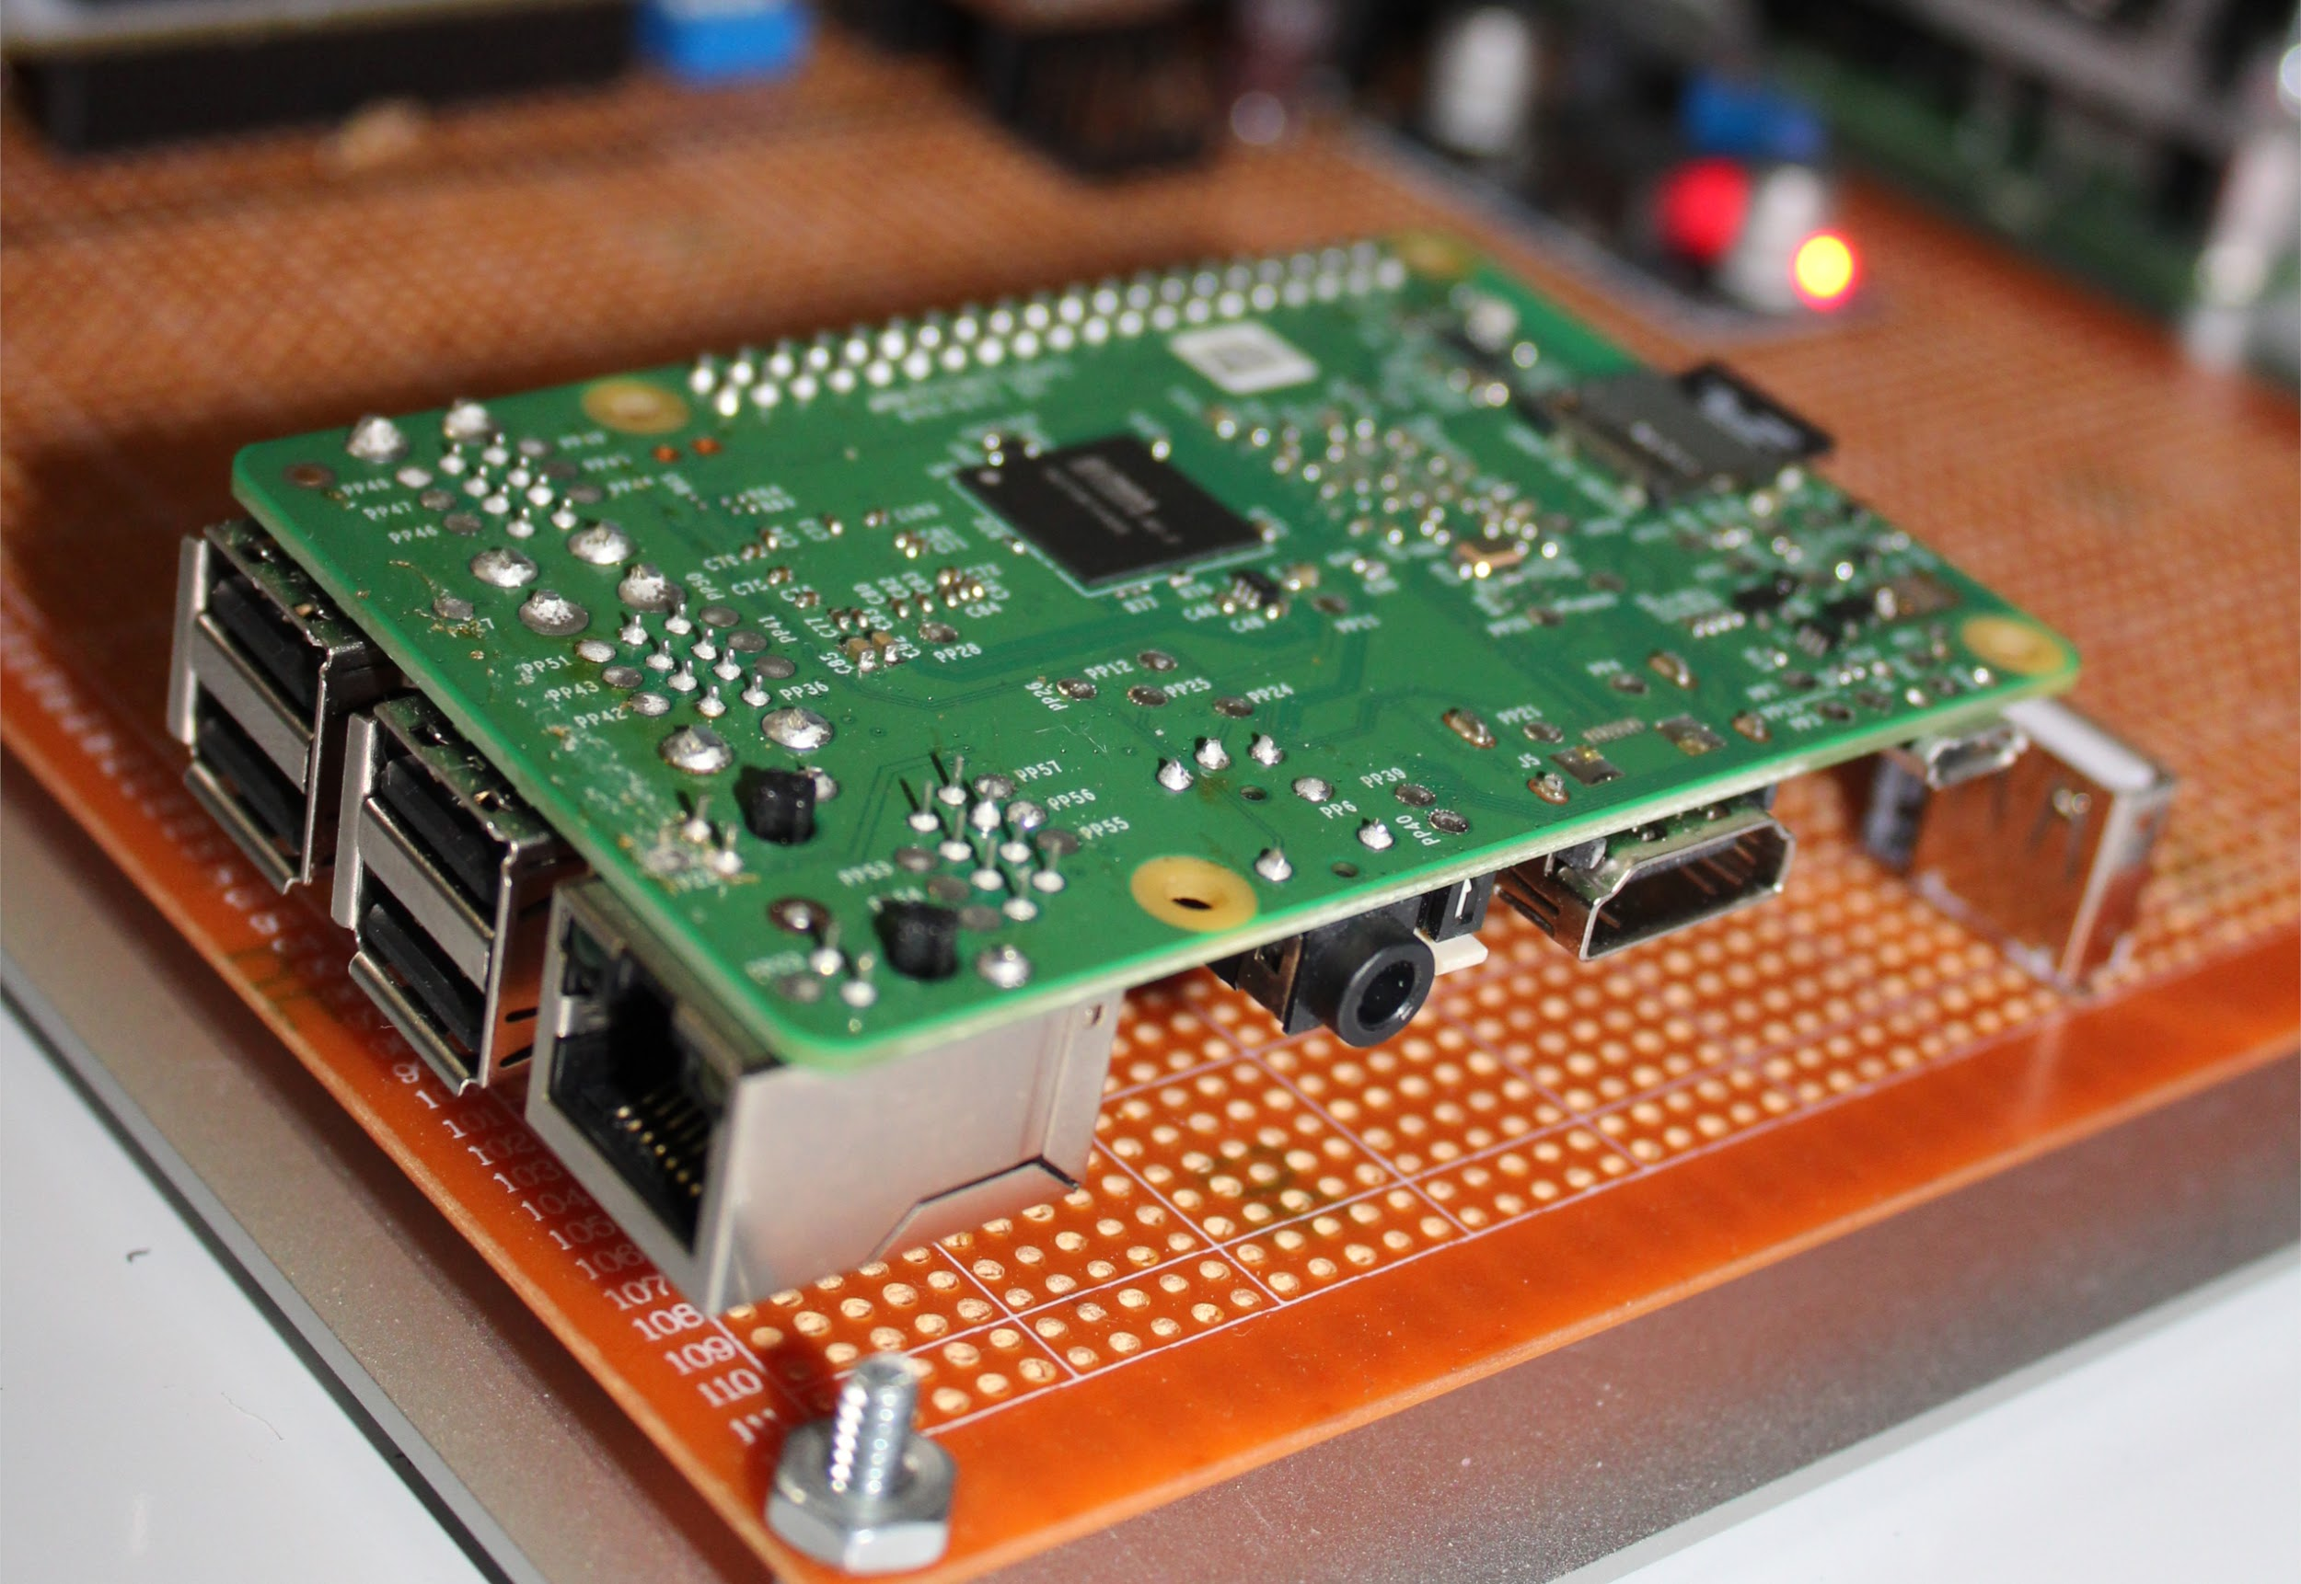
Raspberry PI
Notes:
This wonderful little device is the Raspberry PI. This is the computer that acts as the master control for up to 16 STM Boards. It can receive commands remotely from a web application or locally from the LCD menu.
The Raspberry PI. Serves as the master control for up to 16 XD boards. Receives commands remotely from a web application or locally from the LCD menu. These instructions are then sent to the appropriate board, then executed. Additional Raspberry PIs can be connected to your system to cover virtually any number of water lines.

Slide 11
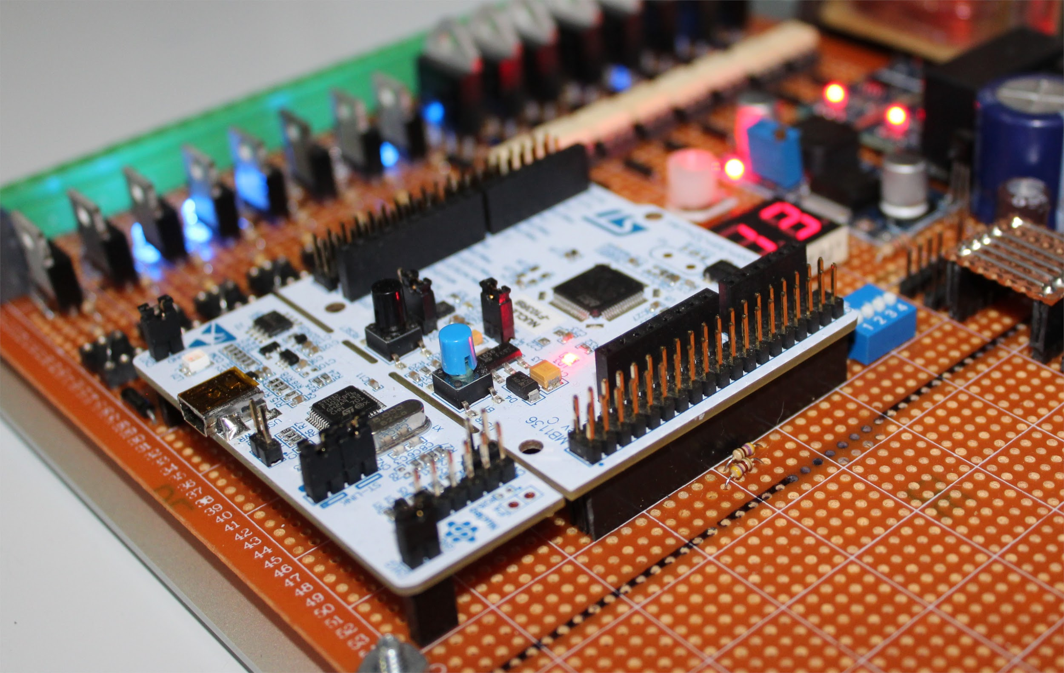
STM32 Microcontroller
Notes:
An STM32 board with an ARM processor. These boards take command from a Raspberry PI in order to control sprinkler valves and to relay sensor information. There can be up to 16 sprinkler valves per board. This allows for up to 256 controlled valves per unit.

Slide 12
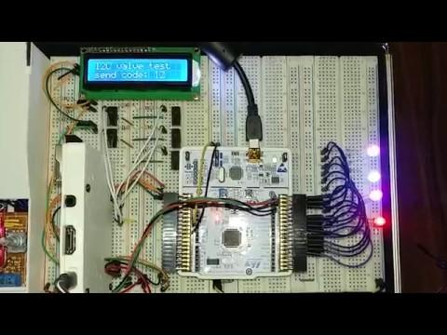
PI to STM Communication Test

Slide 13
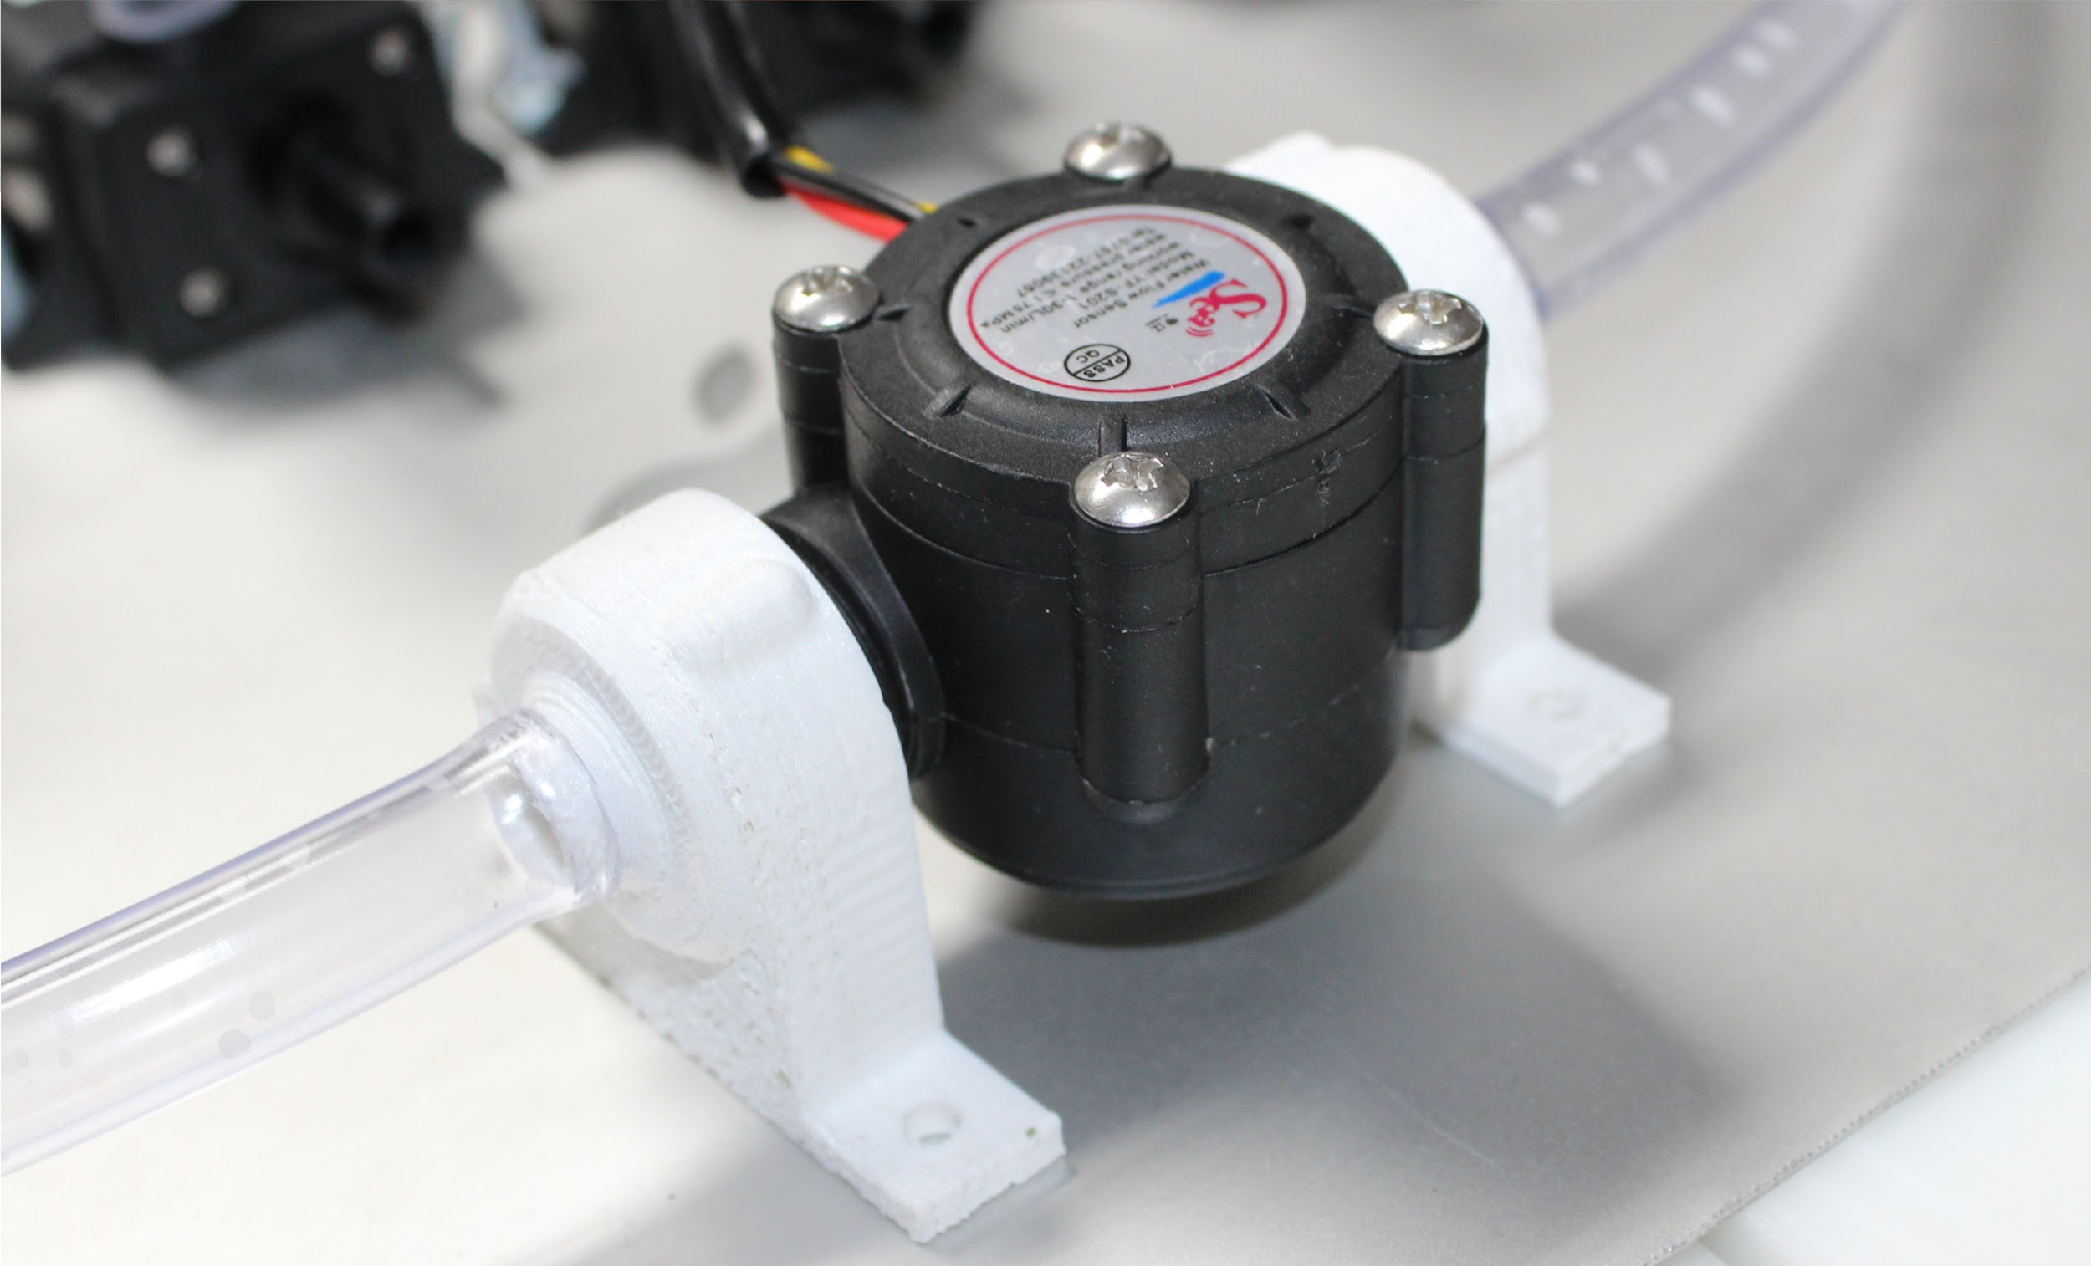
Flow Sensors
Notes:
A flow sensor measures water usage in gallons per minute (GPM). By connecting to a water line and STM32, we can monitor how much water the system is using. This is also useful for detecting broken pipes or valves.

Slide 14


Broken Sprinkler Head
Leaky Pipe
Notes:
If the system detects that water is flowing through the pipes but there isn’t any current coming from the valves we can deduce that there might be a leak. If the flow value is too high we can come to the conclusion that there must be a burst in the pipes. In both of these scenarios the system will shut off immediately

Slide 15
Testing

Slide 16
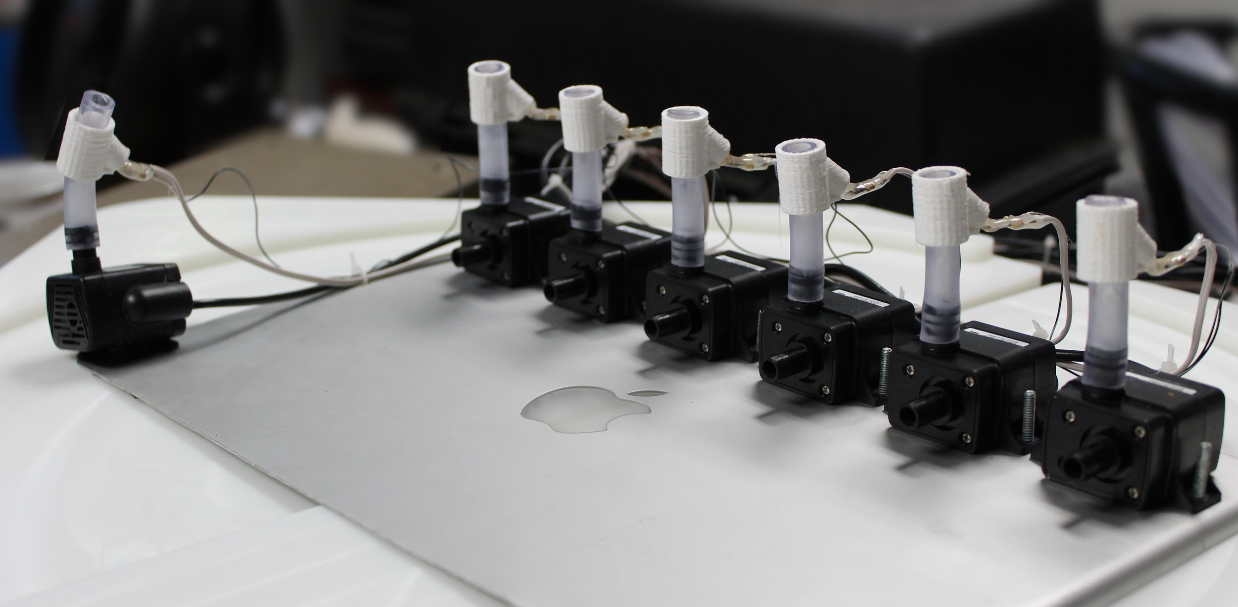
Simulated Irrigation Valves
Notes:
These represent sprinkler valves on a small scale.
Water pumps for testing purposes to see how fast the valves respond to commands and to see if we can get valves to turn on at the same time using a single data bus.
Actual sprinkler valves can be connected in the same manner.

Slide 17
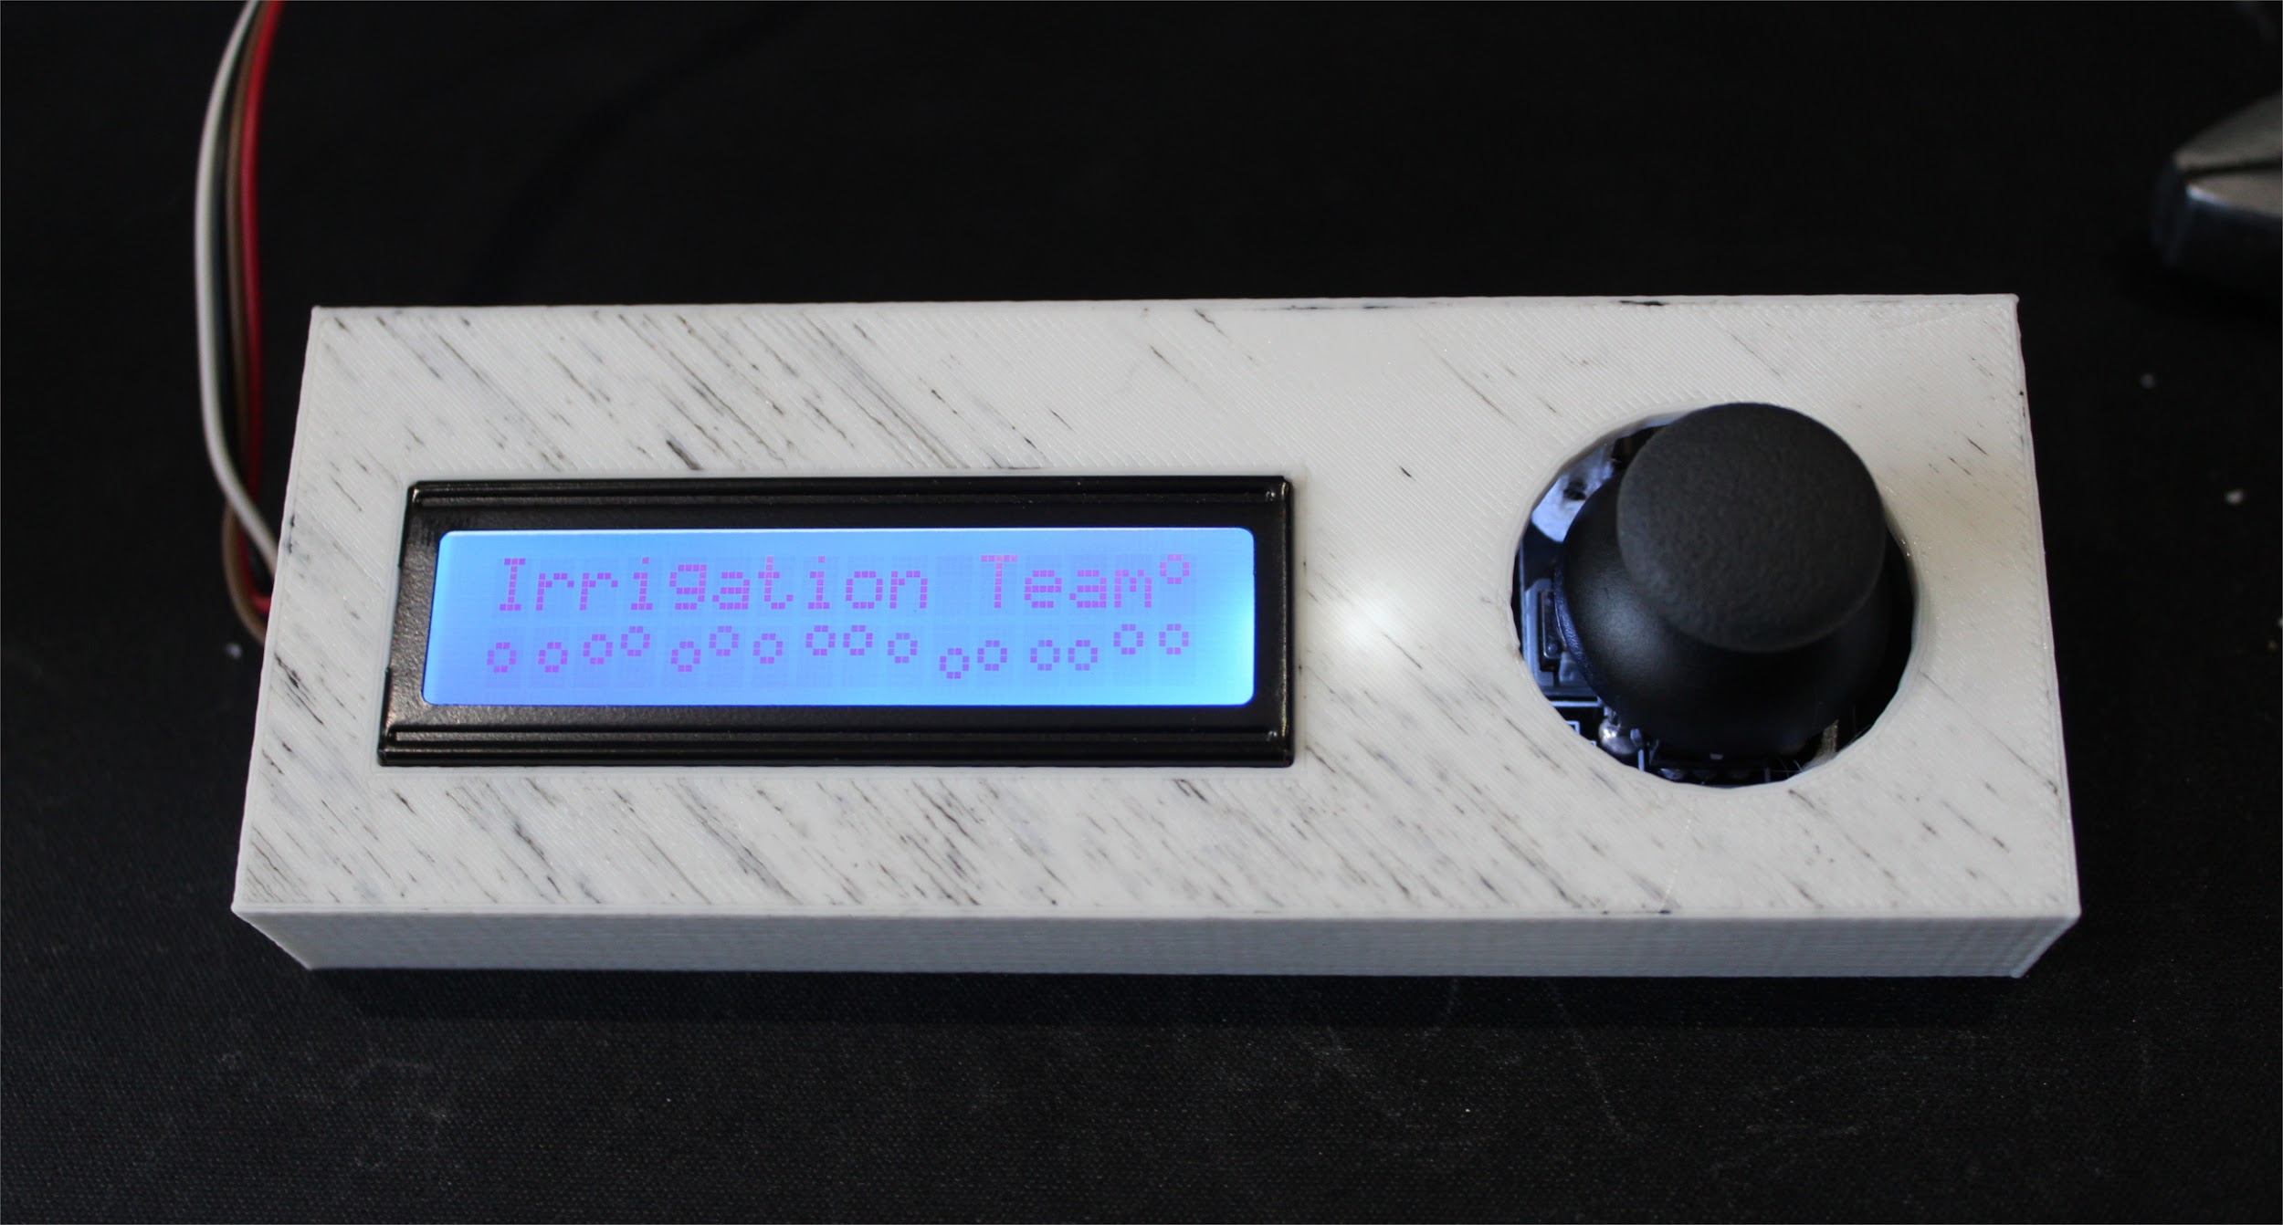
LCD Display
Notes:
A menu module for the Raspberry PI.
Uses an LCD and a joystick.
Uses SPI protocol.
Provides quick access to system information and manual sprinkler controls.
Data on the LCD is updated every time the menu item is displayed on the screen.
Display Date and Time
Display Local Temperature and Humidity
Display IP Address
Control Valves Manually (scroll through menu and toggle on/off state of each one.
Displays current working state of each valve
Display GPM of valve set (IP)

Slide 18

Bellagio 2.0

Slide 19
Diagrams
Notes:
Ian - We have prepared a few technical diagrams that demonstrate our system.

Slide 20
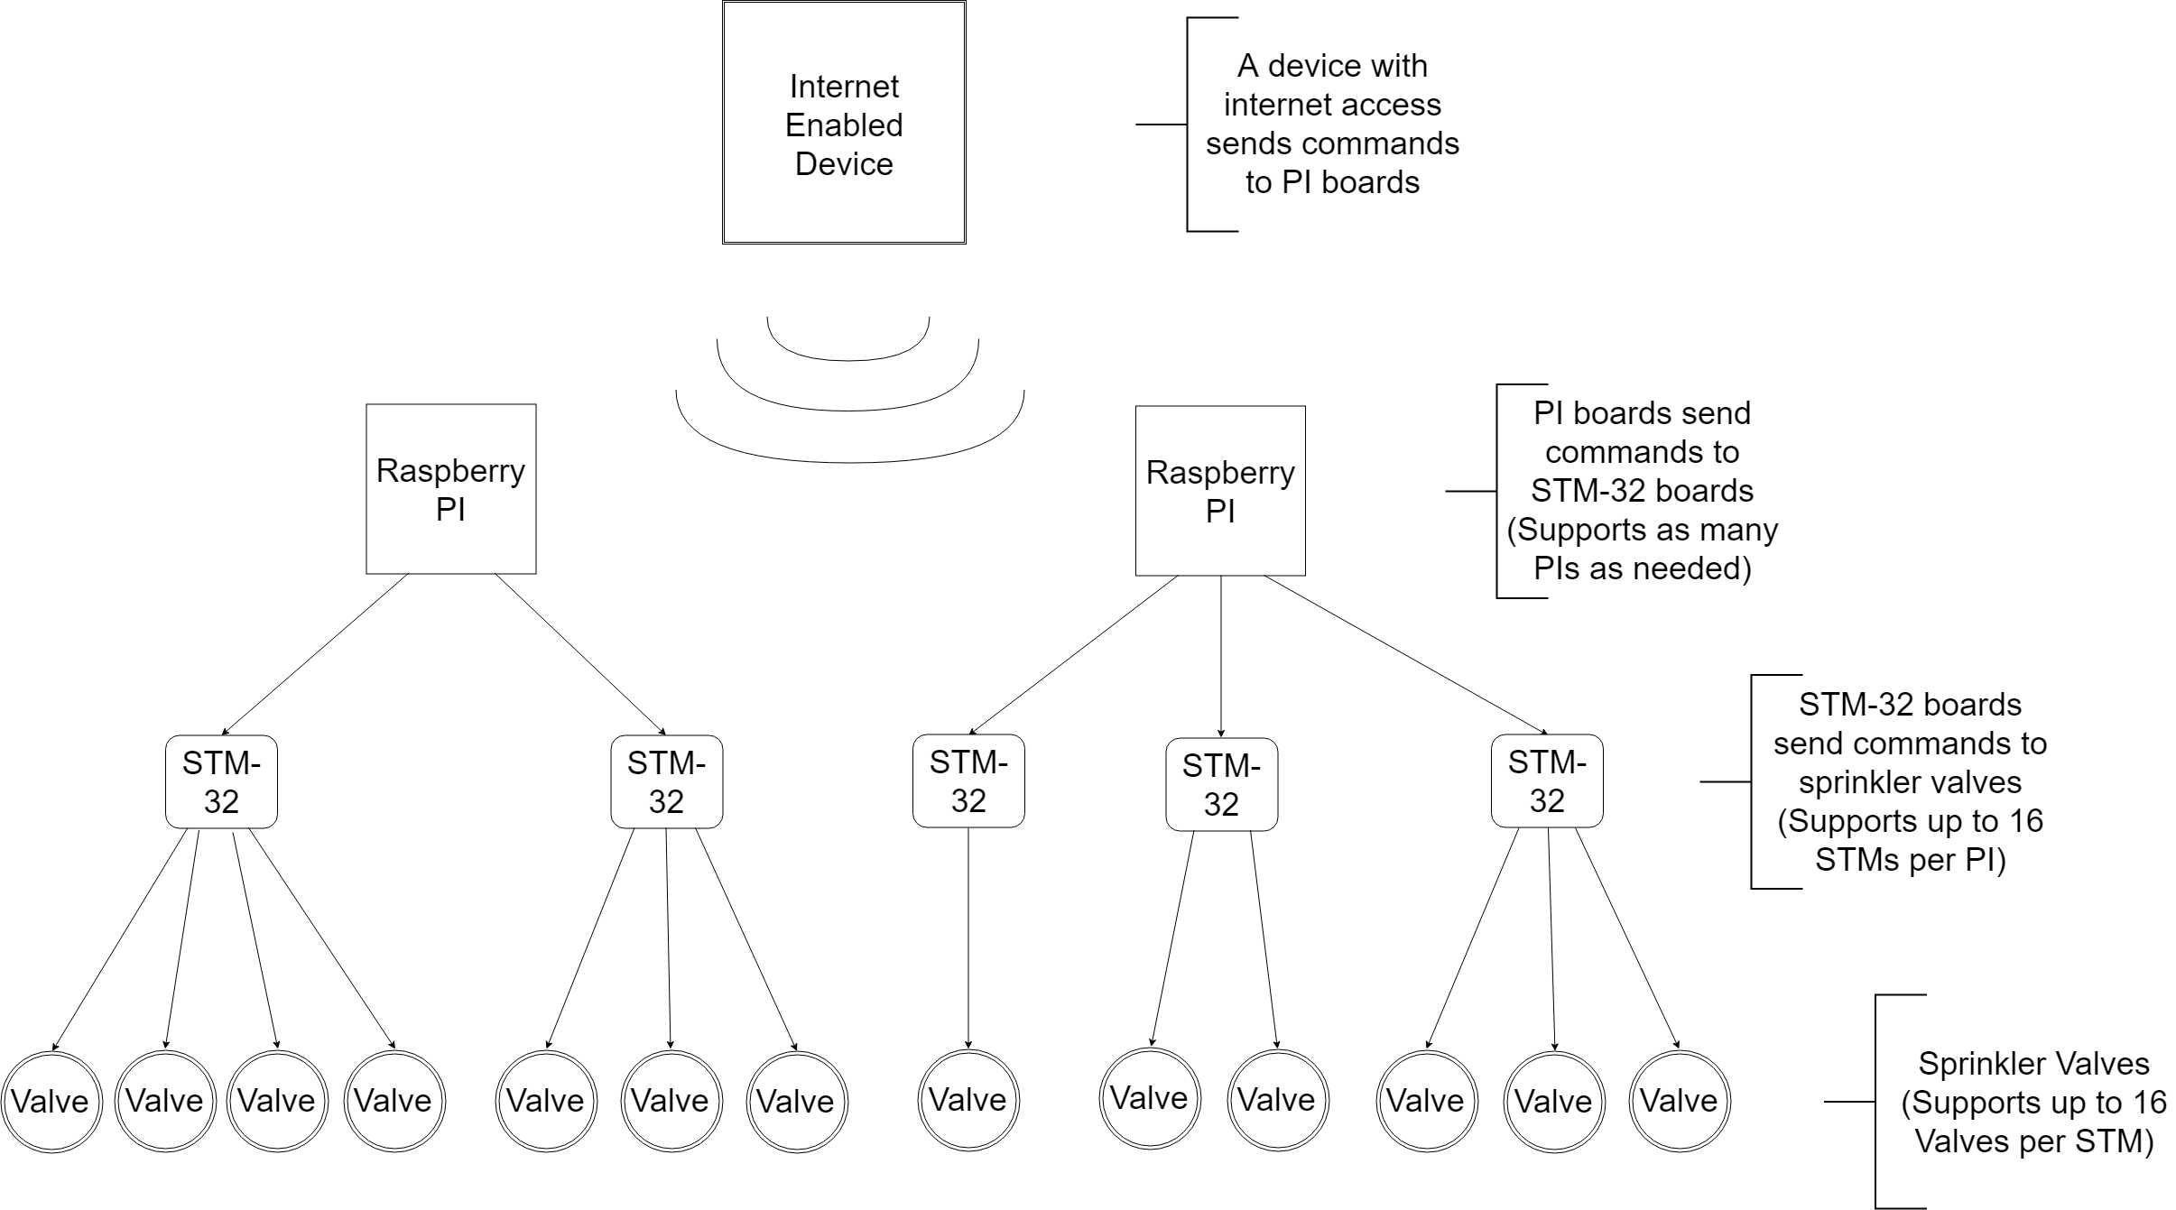
PRODUCT SPECIFICATION
Notes:
This is an overview of how all of the components of the system work together. At the highest level, a web application manages a schedule of when sprinkler valves should turn on, and sends that information to all raspberry pis in the system. The PIs serve as master controllers for up to 16 STM32 boards each. The STM32s take commands from the PIs and control up to 16 sprinkler valves each. This works There can be a nearly unlimited number of raspberry pis, depending on the network they’re connected to. I should note that the web application I mentioned is being developed by a separate team in conjunction with us. They are unfortunately not participating in the senior design showcase.

Slide 21
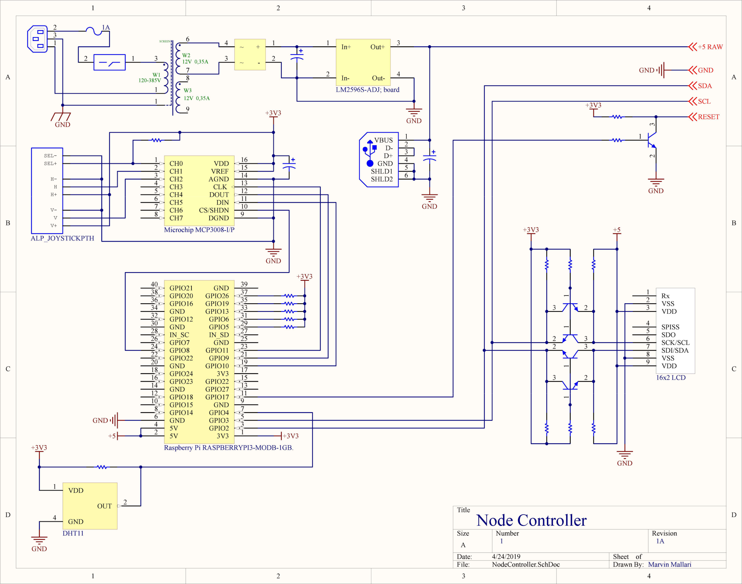
Raspberry Pi Node Controller Schematic
Notes:
This is a circuit diagram of the Raspberry PI and its connected components, including the LCD display. We do not have time to discuss the circuit diagram in depth, but we thought it was important to show that we have carefully planned the design of our devices.

Slide 22
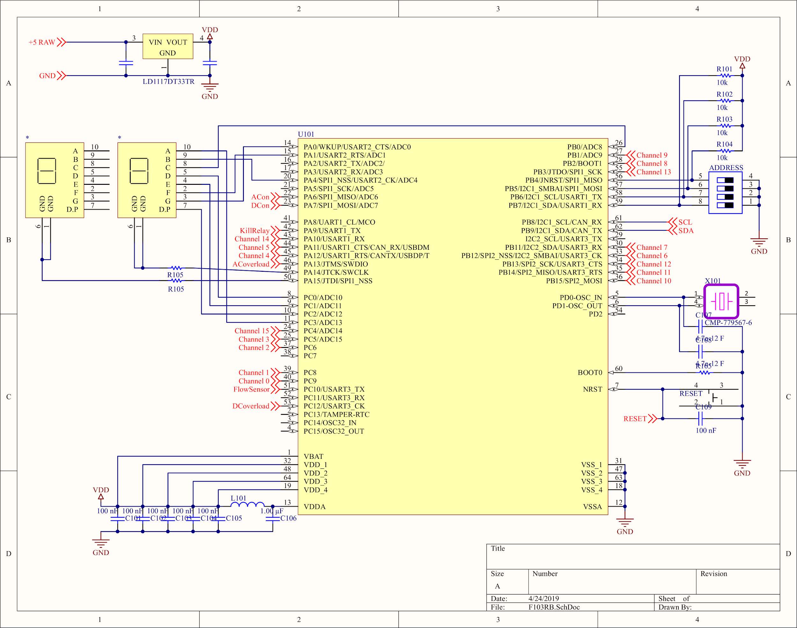
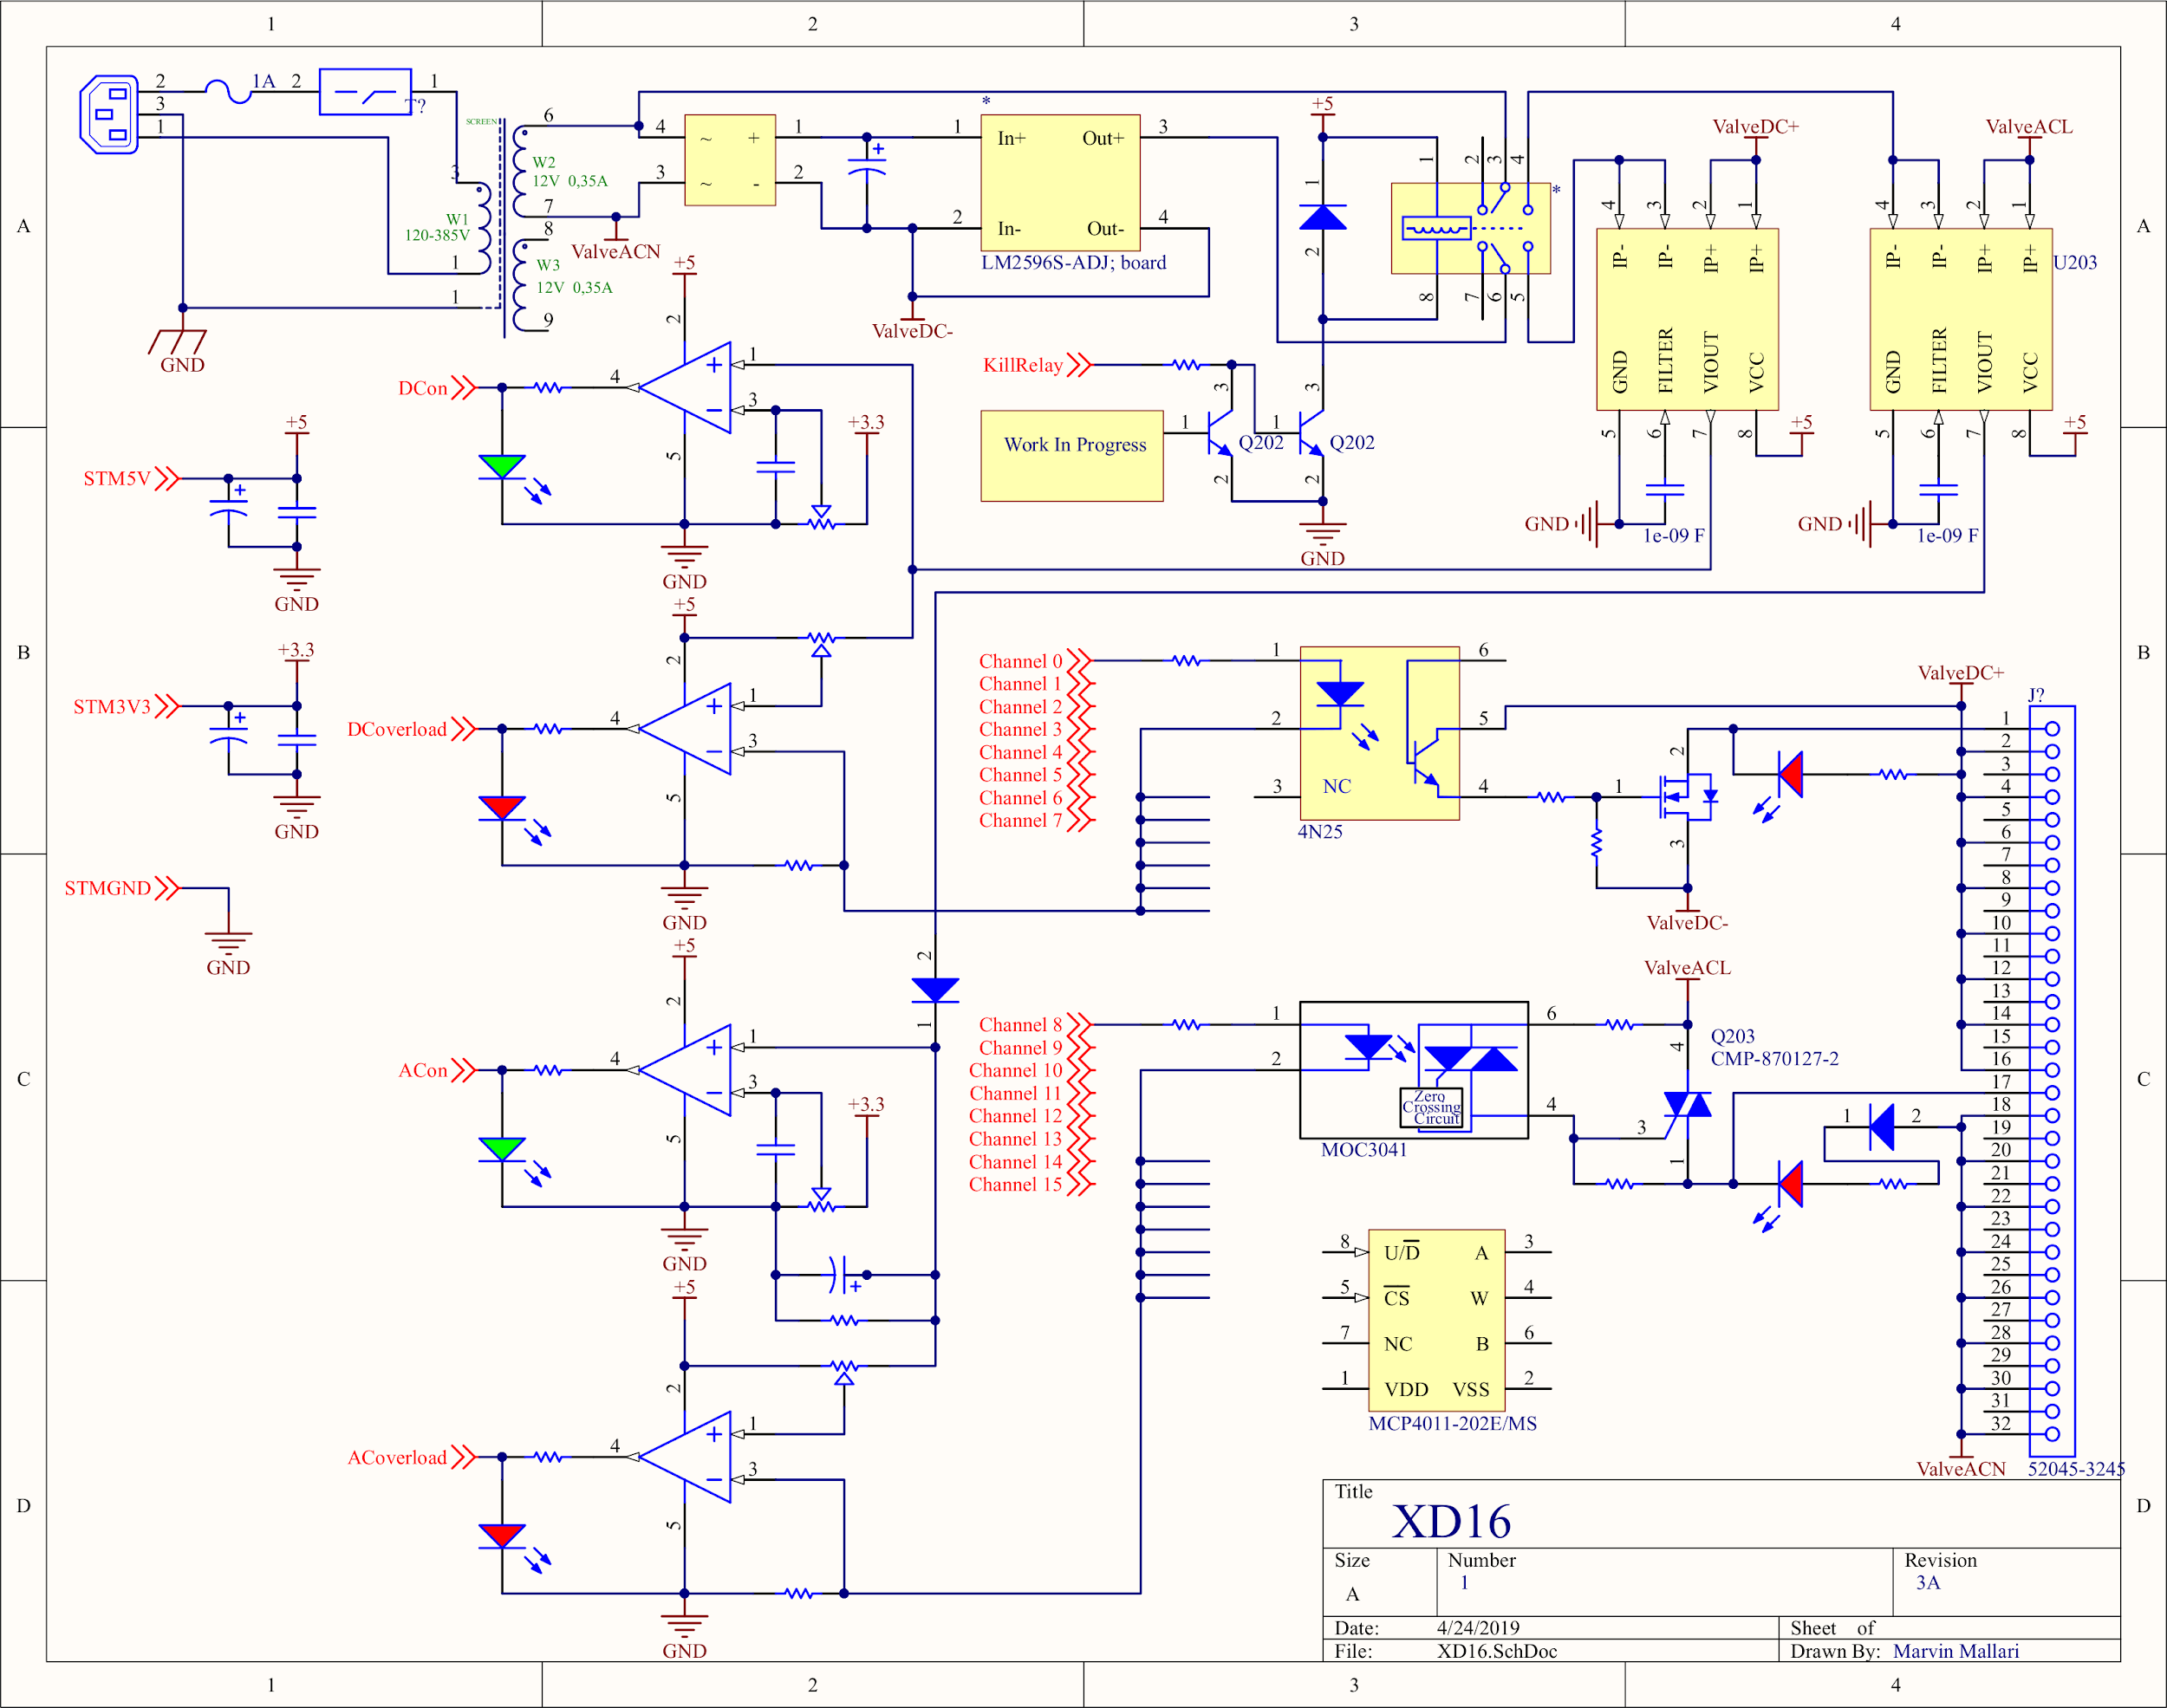
XD16 Valve Handler Schematic
Notes:
This is a circuit diagram of the board that handles controlling the sprinkler valves.

Slide 23
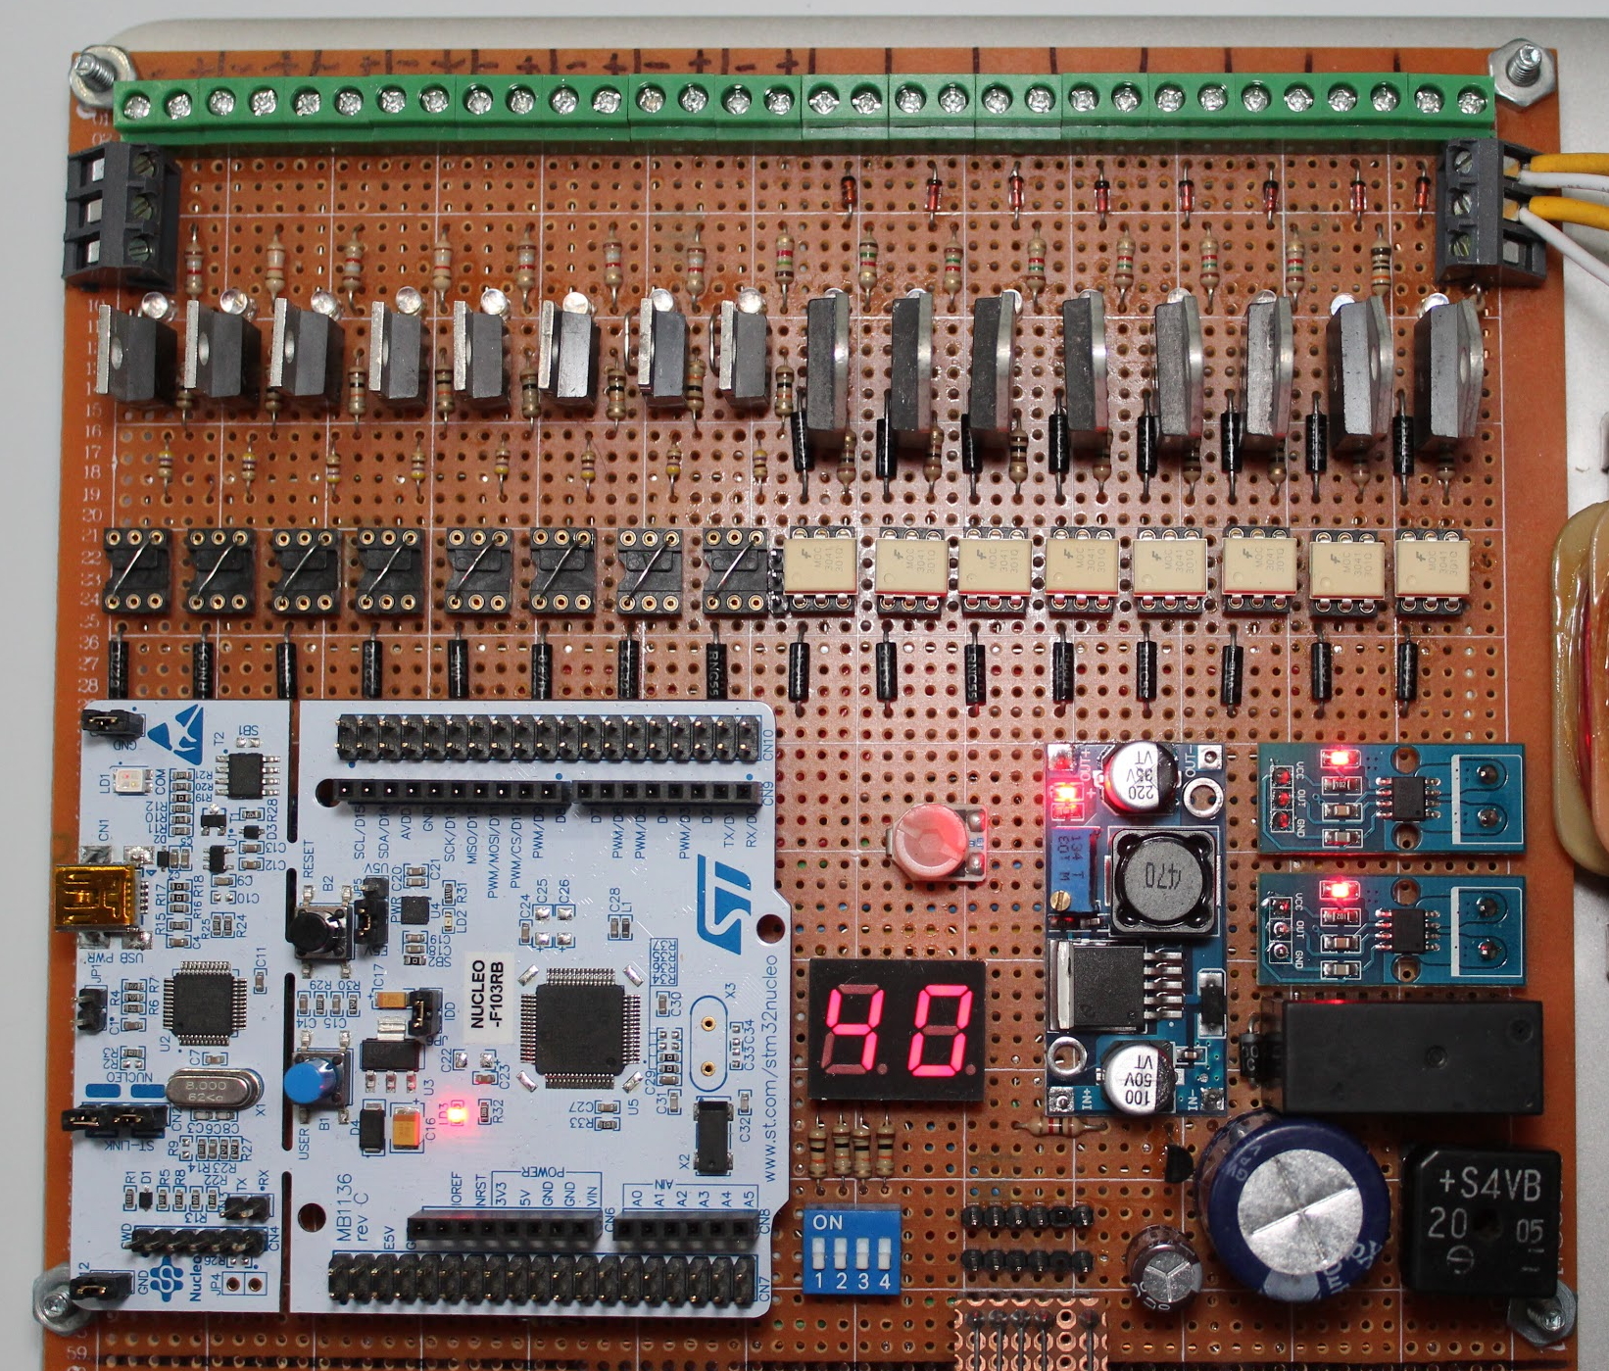
Prototype Circuit Board
Prototype created with THT. Final model will be SMT.
Notes:
This is a picture of the prototype board for the previous circuit diagram. You can see the STM-32 in the lower left corner. The green connectors at the top are connections for the 16 sprinkler valves, which can run AC or DC power. In the middle is an LED display that identifies which of 16 boards you are looking at.

Slide 24
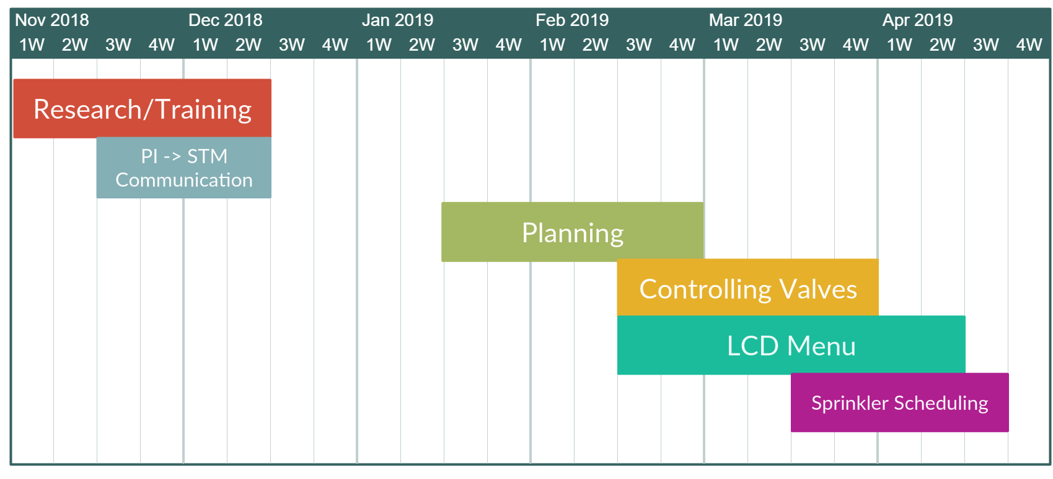
Development Time Line
Notes:
This is a breakdown of the tasks that we have completed since beginning the project. We want to emphasize that what we have shown today is representative of only 5 months of work. Going forward, there is a lot of room for additions and improvements.

Slide 25
Conclusion

Slide 26
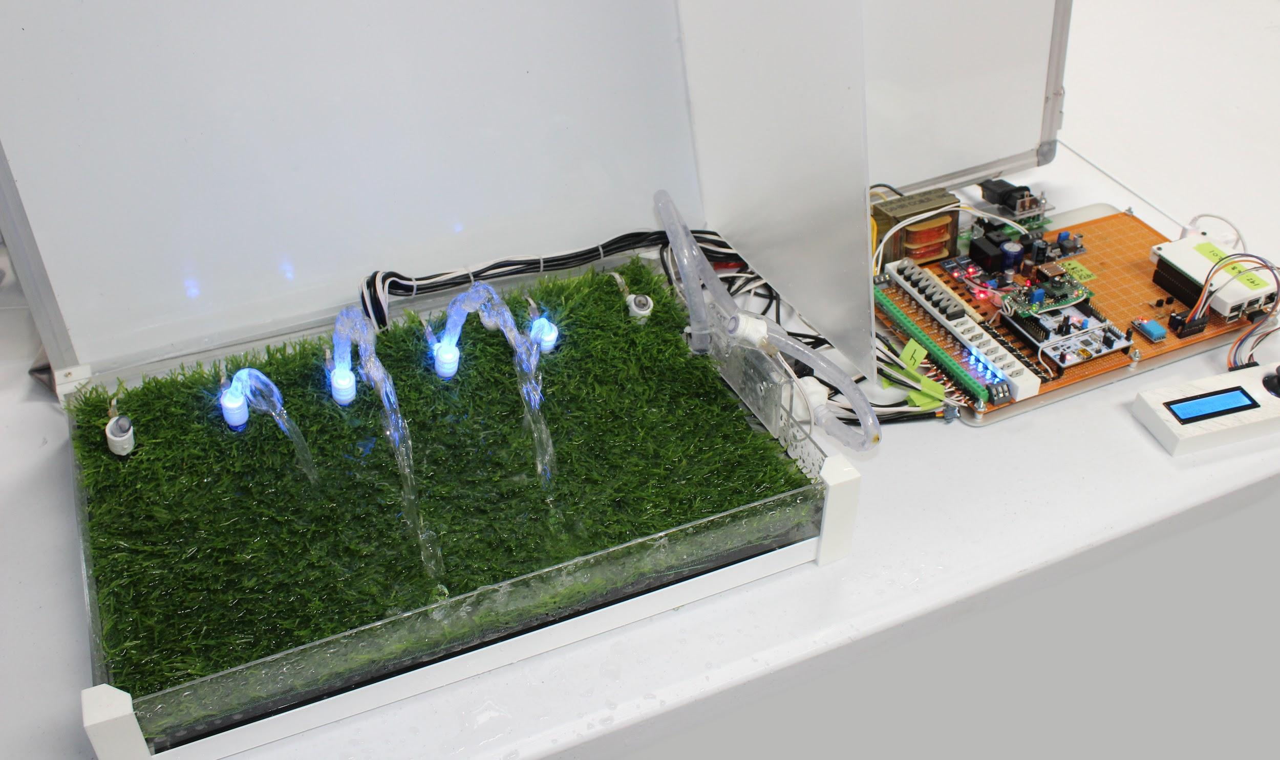
System Summary
Notes:
In summary the prototype provides a scalable, economical, and user friendly Irrigation System that helps alleviate frustration from the outdated, difficult and costly devices on the market today. We believe our product meets and exceeds all consumer expectations.

Slide 27
Future Considerations:
Webpage Scheduler
Error detection/Debugging GUI
Custom boards based on consumer needs
Large Scale Testing
Code optimization
System flexibility depending on the role
Notes:
For Future Considerations we’re going to integrate webpage schedule and improve the GUI. Build custom boards based on the needs of our clients. Implement Large Scale Testing, and optimize code tailored to the client.

Slide 28
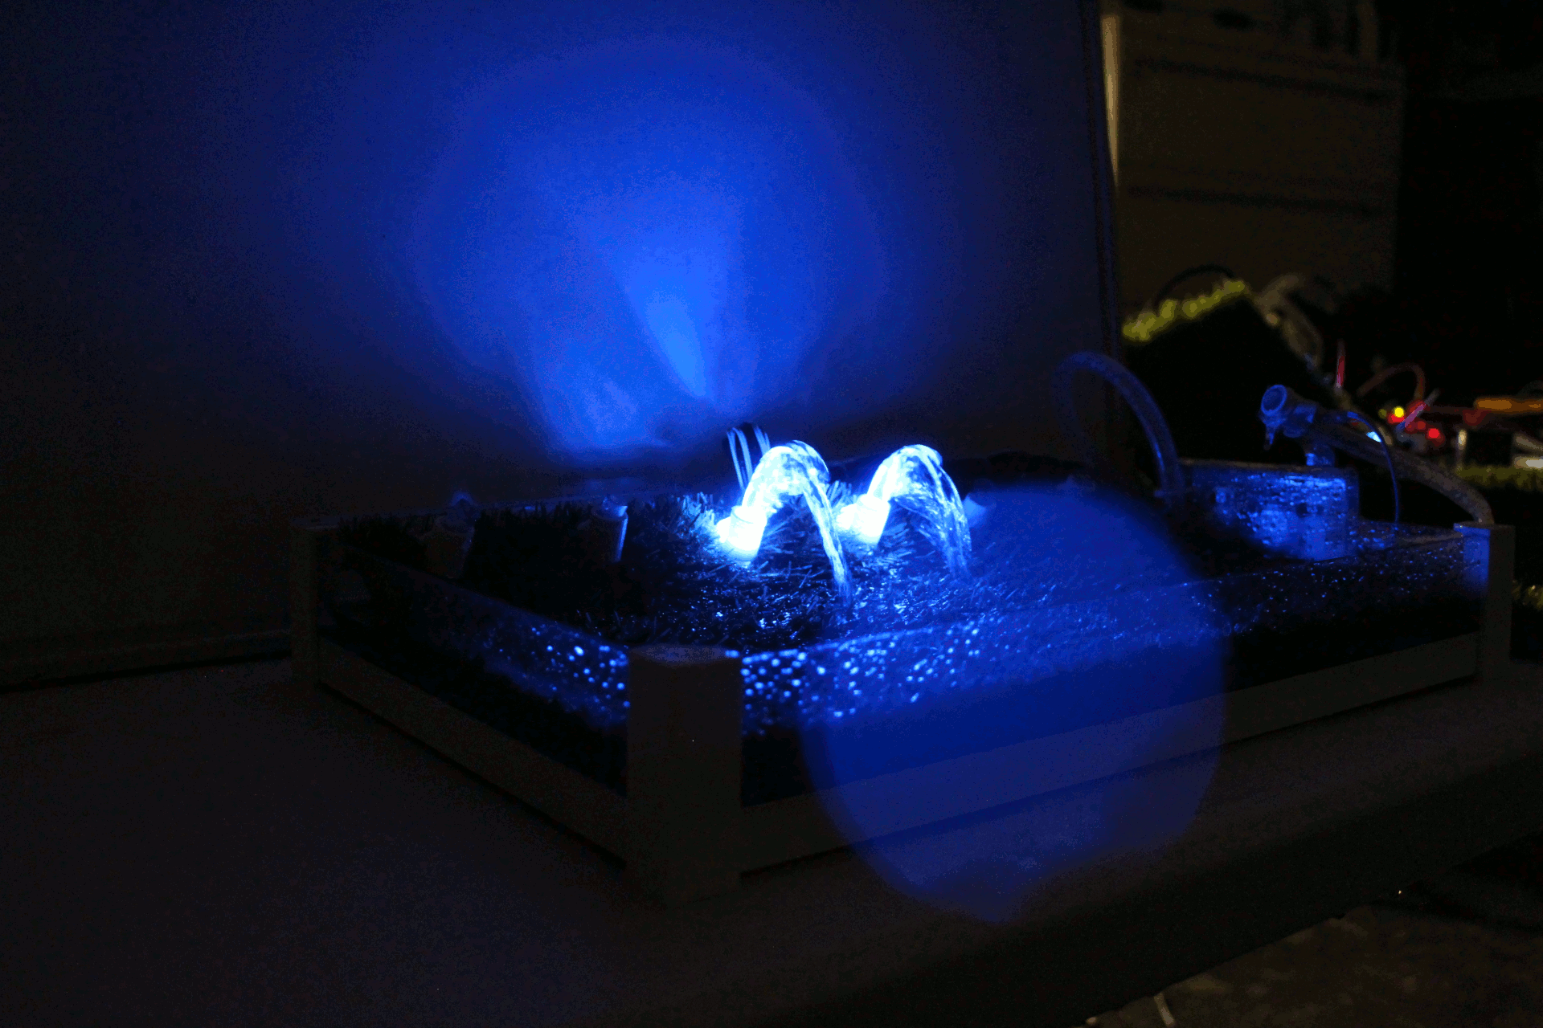
Questions?

